Slide 1
Portfolio Information Collection
Tomas Perveneckas

Slide 2
Main components
Python 3.12+
Docker
InfluxDB

Slide 3
Workflow
Configuration Loading
Fetching data from Trading212 API
Data validation, transformation and enrichment (Pydantic)
Writing data to InfluxDB

Slide 4
Running the program periodically
Linux machine with Docker
Docker image built with the included Dockerfile in the repository
Crontab configured to run a Docker container every X minutes, based on the image that was built previously:
*/15 * * * * docker run --env-file ~/projects/stock-info-collection/.env -d --rm --name stock-info-collection --network="bridge" tomas/stock-info-collection:v1.1

Slide 5
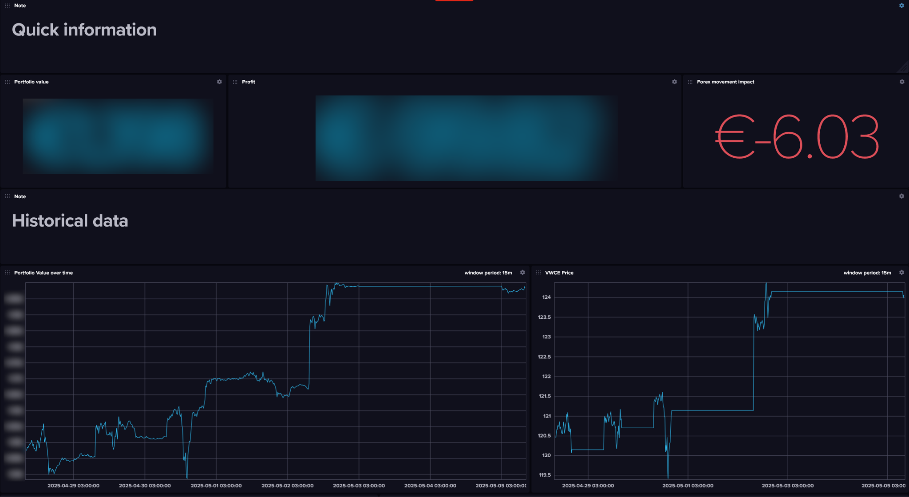
Dashboards

Slide 6
